Slide 1
FINAL PROJECT:
Analyzing Feature Importance in Customer Churn Using Shapley Values
Group member
An To Vinh - Chinh Nguyen Minh - Anh Thien Tran

Slide 2

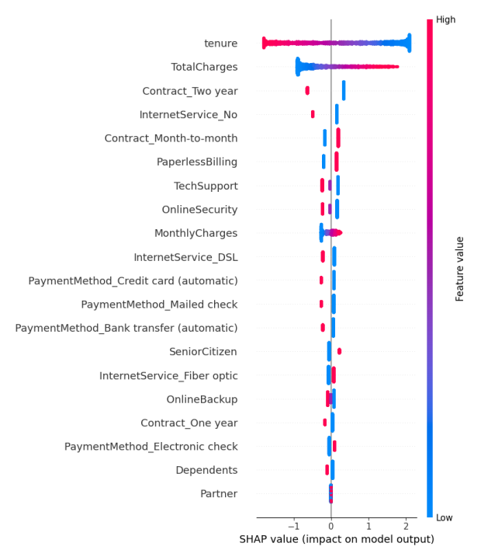
Abstract
Abstract | Introduction | Method | Experiments and Results | Production: Streamlit Demo | Conclusion and Tasks Assigned

Slide 3
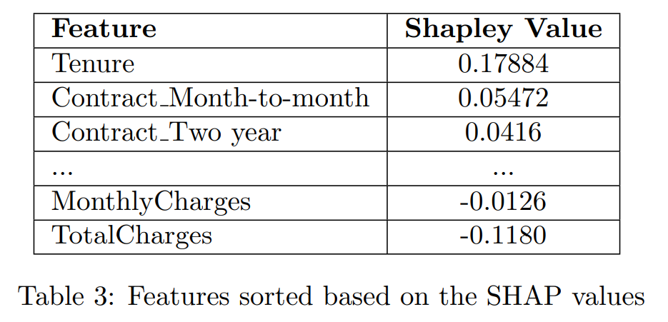


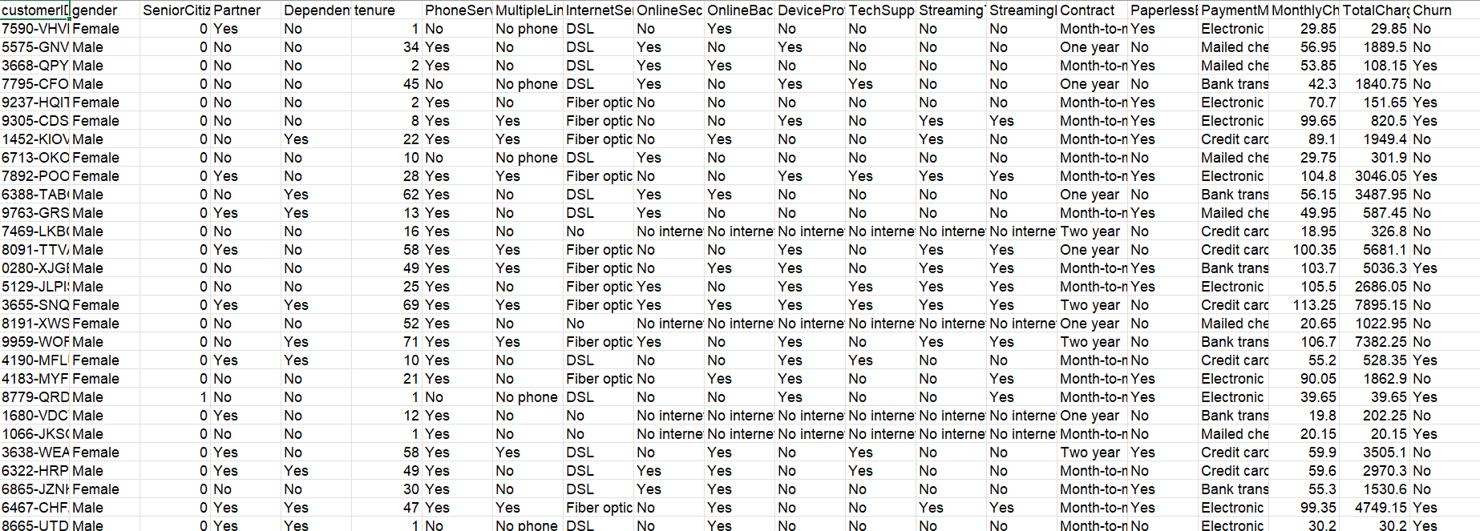
Abstract
Dataset
Shapley Value
Abstract | Introduction | Method | Experiments and Results | Production: Streamlit Demo | Conclusion and Tasks Assigned

Slide 4
Abstract
Dataset
Abstract | Introduction | Method | Experiments and Results | Production: Streamlit Demo | Conclusion and Tasks Assigned

Slide 5
Abstract
Dataset
Shapley Value
Abstract | Introduction | Method | Experiments and Results | Production: Streamlit Demo | Conclusion and Tasks Assigned

Slide 6
Abstract
Abstract | Introduction | Method | Experiments and Results | Production: Streamlit Demo | Conclusion and Tasks Assigned

Slide 7



Introduction
 | Introduction

Slide 8
Method
https://colab.research.google.com/drive/12bz4mrPHu2pUDoFRv6mBP8YTi3Fvd-th?usp=sharing&fbclid=IwY2xjawHUnLhleHRuA2FlbQIxMAABHXhg5pg_5epFwCqW50DGeKOY_CuUPz9UEqI-Io0p-_LCVqjx86tUuaf16w_aem_Soxw38HgUjnQshqTV0zV1g#scrollTo=neLuQzQD2jvz
 |  | Method

Slide 9
Method
SHAP (Shapley Additive Explaination)
HOW IT WORK?
 |  | Method

Slide 10







SHAP (Shapley Additive Explanations)
Samples
Features
Target
Age
Money Spent
Time Spent
Churn

Slide 11
SHAP (Shapley Additive Explanations)
30 | 500.000 | 12
40 | 300.000 | 5
25 | 700.000 | 3

Slide 12
SHAP (Shapley Additive Explanations)
30 | 500.000 | 12
0.2
40 | 300.000 | 5
0.7
25 | 700.000 | 3
0.1

Slide 13
SHAP (Shapley Additive Explanations)
Step to step

Slide 14
SHAP (Shapley Additive Explanations)
Step 1. Training a model using Logistic Regression
Dataset
Logistic Regression
Weight
30 | 500.000 | 12
w1 | w2 | w3
40 | 300.000 | 5

Slide 15
SHAP (Shapley Additive Explanations)
Step 2: Choose a feature to consider.

Slide 16
SHAP (Shapley Additive Explanations)
Step 2: Choose a feature to consider.

Slide 17
SHAP (Shapley Additive Explanations)
Step 3: Consider all combinations without the feature chosen

Slide 18
SHAP (Shapley Additive Explanations)
Step 3: Consider all combinations without the feature chosen

Slide 19
SHAP (Shapley Additive Explanations)
Step 4: At each combination

Slide 20
SHAP (Shapley Additive Explanations)
Step 4. At each combination, consider each sample

Slide 21
SHAP (Shapley Additive Explanations)
Step 4. At each combination, consider each sample

Slide 22
SHAP (Shapley Additive Explanations)
Step 5. Compute the Shapley Value

Slide 23
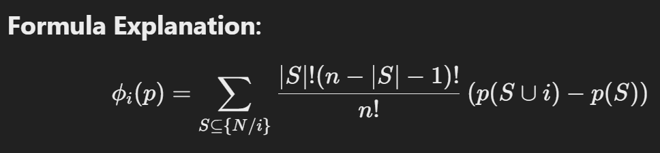
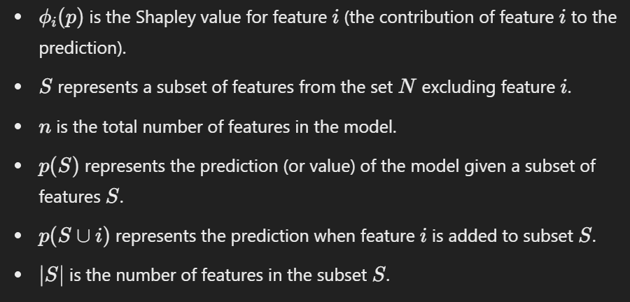
SHAP (Shapley Additive Explanations)

Slide 24
SHAP (Shapley Additive Explanations)
Step 5. Compute the Shapley Value
S = {Money Spent}
n = 3
p(S) = Sigmoid(w2 * Money Spent)
p(S ∪ i) = Sigmoid(w1 * Age + w2 * Money Spent)
∣S∣ = 1

Slide 25
SHAP (Shapley Additive Explanations)
Step 6. Return to step 4 and loop for all samples

Slide 26
SHAP (Shapley Additive Explanations)
Step 6. Return to step 4 and loop for all samples Compute the average Shapley value of all samples
+
+
3

Slide 27
SHAP (Shapley Additive Explanations)
Step 7: Return to step 3 and loop for all combinations Compute the sum Shapley value of all combinations
+
+

Slide 28
SHAP (Shapley Additive Explanations)
+
+
Shapley Value of Feature “Age“

Slide 29
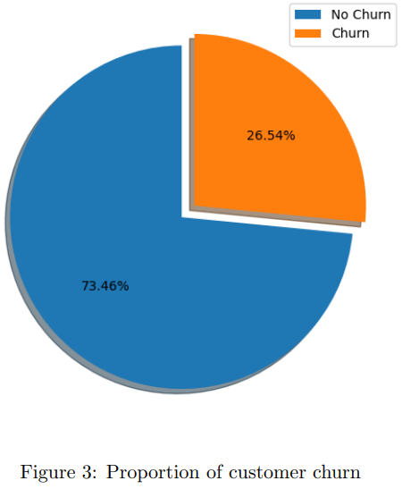
Fold 2
Fold 3
Fold 4
Fold 5
Experiments And Results
1. Stratified k-fold Cross-Validation
Sample 1 | Sample 2 | Sample 3 | Sample 4 | Sample 5 | Sample 6 | ... | Sample n
Fold 1 | Fold 2 | Fold 3 | Fold 4 | Fold 5
 |  |  | Experiments and Results

Slide 30
Fold 2
Fold 3
Fold 4
Fold 5
Experiments And Results
1. Stratified k-fold Cross-Validation
Fold 1 | Fold 2 | Fold 3 | Fold 4 | Fold 5
Train
Test
Fold 2 | Fold 3 | Fold 4 | Fold 5
Fold 1
Fold 1 | Fold 3 | Fold 4 | Fold 5
Fold 2
Fold 1 | Fold 2 | Fold 4 | Fold 5
Fold 3
Fold 1 | Fold 2 | Fold 3 | Fold 5
Fold 4
Fold 1 | Fold 2 | Fold 3 | Fold 4
Fold 5
 |  |  | Experiments and Results

Slide 31
Fold 2
Fold 3
Fold 4
Fold 5
Experiments And Results
1. Stratified k-fold Cross-Validation
Fold 1 | Fold 2 | Fold 3 | Fold 4 | Fold 5
Train
Test
Fold 2 | Fold 3 | Fold 4 | Fold 5
Fold 1
Accuracy 1
Fold 1 | Fold 3 | Fold 4 | Fold 5
Fold 2
Accuracy 2
Fold 1 | Fold 2 | Fold 4 | Fold 5
Fold 3
Accuracy 3
Fold 1 | Fold 2 | Fold 3 | Fold 5
Fold 4
Accuracy 4
Fold 1 | Fold 2 | Fold 3 | Fold 4
Fold 5
Accuracy 5
 |  |  | Experiments and Results

Slide 32
Fold 2
Fold 3
Fold 4
Fold 5
Experiments And Results
1. Stratified k-fold Cross-Validation
Fold 1 | Fold 2 | Fold 3 | Fold 4 | Fold 5
Accuracy 1
+
Accuracy 2
+
Accuracy 3
+
Accuracy 4
+
Accuracy 5
5
= Cross Validation Accuracy (5 Fold)
 |  |  | Experiments and Results

Slide 33
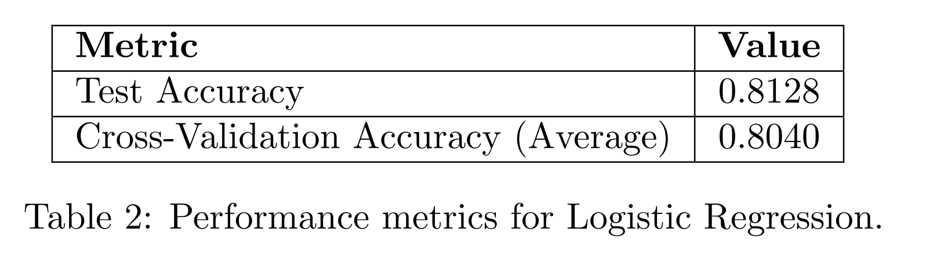
Fold 2
Fold 3
Fold 4
Fold 5
Experiments And Results
2. Model Performance
 |  |  | Experiments and Results

Slide 34
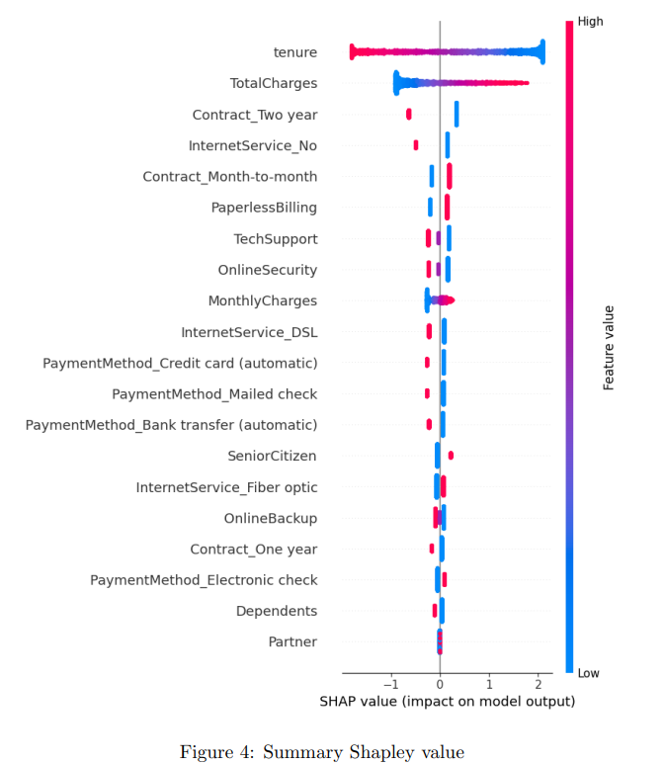
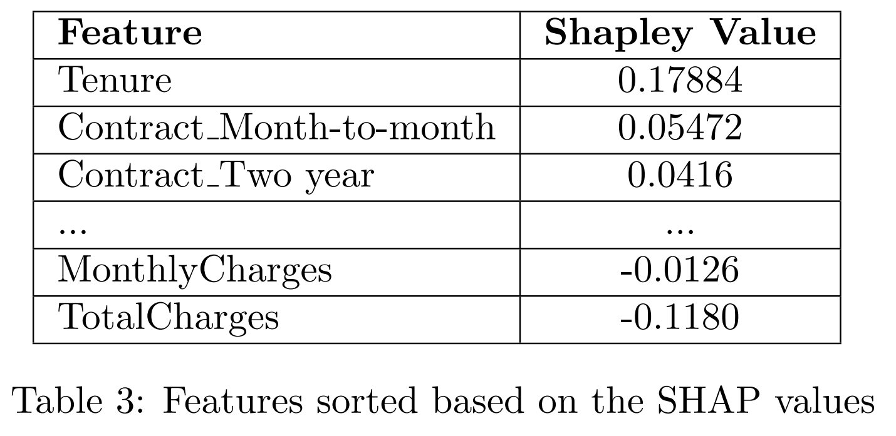
Fold 2
Fold 3
Fold 4
Fold 5
Experiments And Results
3. Feature Importance
 |  |  | Experiments and Results

Slide 35
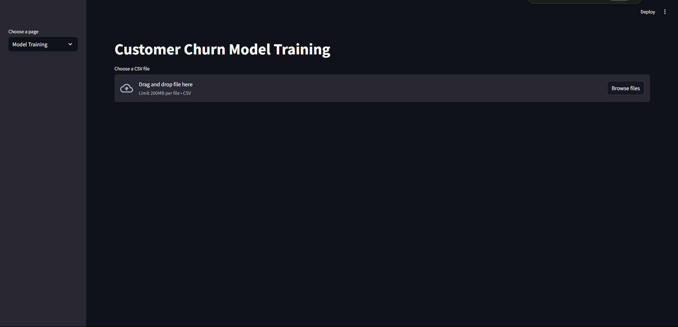
Fold 2
Fold 3
Fold 4
Fold 5
 |  |  |  | Production: Streamlit Demo

Slide 36

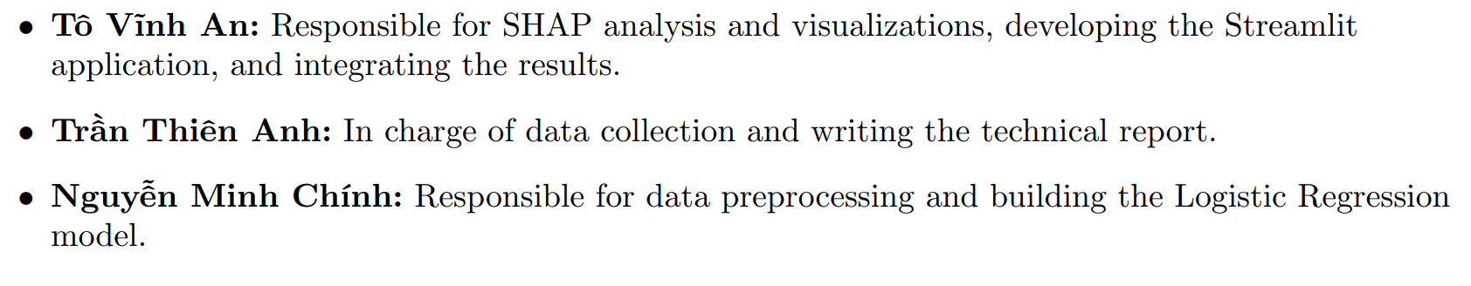
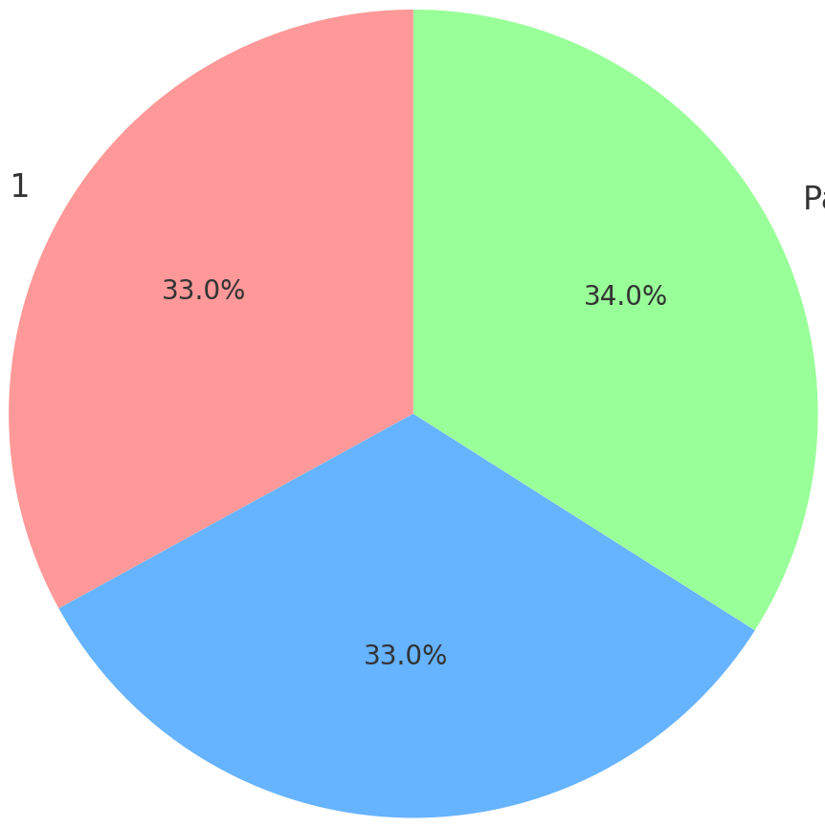
Fold 2
Fold 3
Fold 4
Fold 5
An To Vinh
1/3
1/3
Thien Tran Anh
1/3
Chinh Nguyen MInh
 |  |  |  |  | Conclusion and Tasks Assigned

